Slide 1
Car Insurance Analysis

Slide 2
Table of contents
01
02
03
04
Introduction
Data Description
Data Cleaning Steps
DashBoard
Data Visualization By Python
05

Slide 3
01
Intoduction

Slide 4
Introduction
In this analysis, we explore a comprehensive dataset containing information about automobile insurance policyholders. This dataset encompasses various demographic and behavioral attributes that are critical in assessing insurance risk and pricing.

Slide 5
02 Data Description

Slide 6
Data Description
column name | Description | hypothetical effect
ID | Identification
KIDSDRIV | number of driving children | children driving cars means a higher risk of collision
BIRTH | date of driver’s birth
AGE | age of driver | younger drivers tend to be riskier
HOMEKIDS | number of children at home | having children may reduce tendencies of driving dangerously
INCOME | income | less income may cause risk in paying insurance premiums

Slide 7
Data Description
column name | Description | hypothetical effect
PARENT1 | single parent | single parents may be more tired and possibly less alert
HOME_VAL | home value | higher home values may be correlated with income
MSTATUS | marital status | single and married people may have different driving behaviors
GENDER | Gender | urban legends says that women crash less than men do
EDUCATION | highest level of education | more educated people should be more careful when driving
OCUUPATION | seniority at work | different levels of profession may be correlate with different driving styles

Slide 8
Data Description
column name | Description | hypothetical effect
TRAVTIME | distance to work | longer journeys are at higher risk of collisions than shorter ones
CAR_USE | purpose of vehicle | private and commercial vehicles may be driven differentially
BLUEBOOK | value of vehicle | the higher price of the car the more careful its driver
TIF | time in-force | time the policy has been in force longer term customers
CAR_TYPE | type of vehicle | unknown effect
RED_CAR | whether or not the car color is red | another urban legend amongst insurers that red cars are riskier

Slide 9
Data Description
column name | Description | hypothetical effect
OLDCLAIM | total claims in the past 5 years | previous behavior as an indicator of future likelihood
CLM_FREQ | claim frequency in the past 5 years | previous behavior as an indicator of future likelihood
REVOKED | license revoked in the past 7 years | having license revoked is an indication of bad road behavior
MVR_PTS | motor vehicle record points | if there are lots of traffic violations there may be higher risk of collisions
CLAIM_AMT | claim amount | claim amount if a claim occurred

Slide 10
Data Description
column name | Description | hypothetical effect
CAR_AGE | age of car | newer cars tend to have more safety features
CLAIM_FLAG | claim or no claim | true/false of whether a claim occurred
URBANCITY | urban or rural | urban environments may have more vehicle density than rural areas

Slide 11
03
Data Cleaning Steps

Slide 12
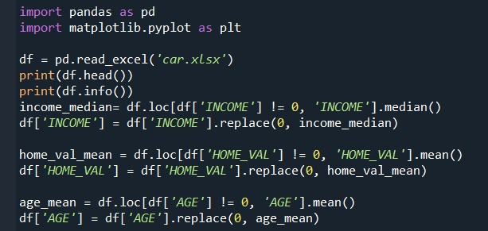
Data Cleaning Steps
Replacing zeroes by mean or median.

Slide 13
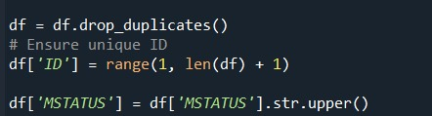
Data Cleaning Steps
Removing Duplicates.
Ensure that ID is unique.

Slide 14
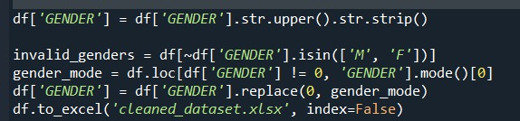
Data Cleaning Steps
Filling missing data in Gender By mode.

Slide 15
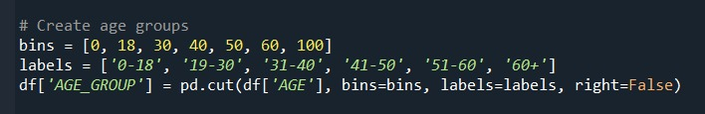
Data Cleaning Steps
Creating Age Groups.

Slide 16
04 Dashboard

Slide 17
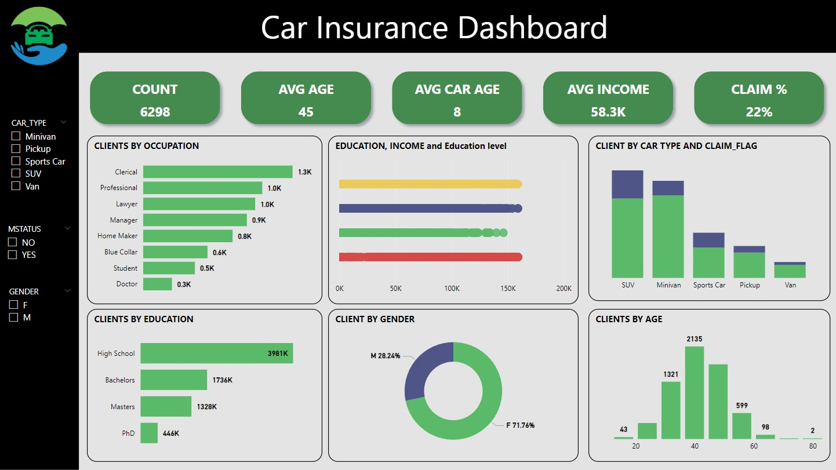

Slide 18
05 Data Visualization By Python

Slide 19
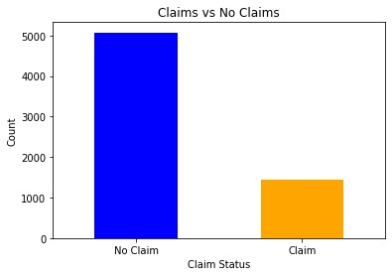
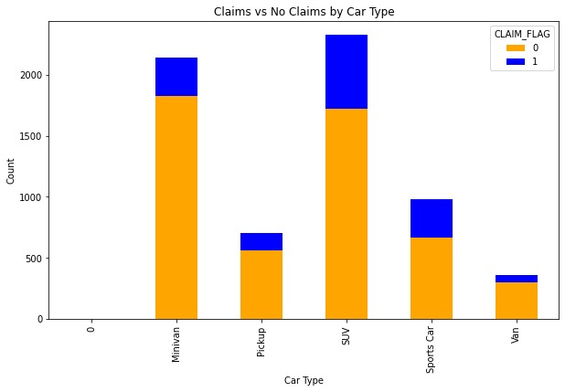
Data Visualization By Python

Slide 20
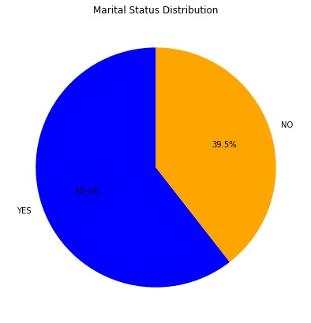
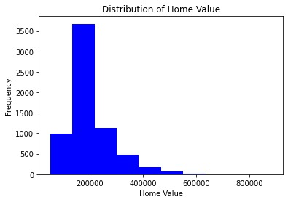
Data Visualization By Python

Slide 21
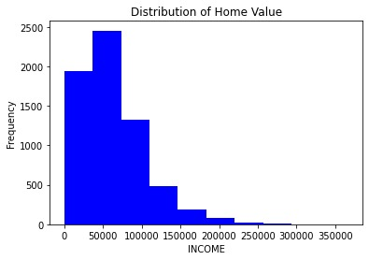
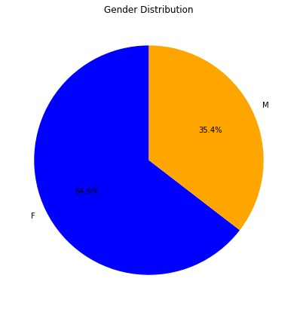
Data Visualization By Python

Slide 22
Team Work
Mahmoud Mohamed Zaki Doaa Ibrahim Mohamed Rahma Nabil Smaa Mohamed Hasan

Slide 23
Thanks!

